Slide 1


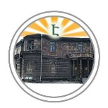

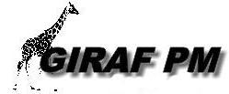







2nd Summer School
Sustainable and Innovative
Approaches for Environmental Safety
11-13 July 2022

Slide 2
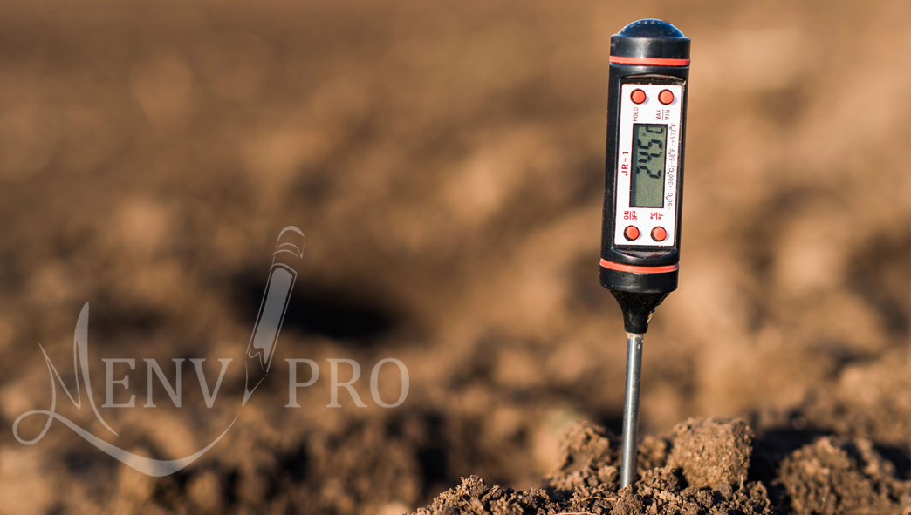
Measuring devices used in environmental sciences
11 July 2022

Slide 3

Measuring devices used in environmental sciences
Avto Tavkhelidze
Ilia State University

Slide 4
Content
Principles of operation of Scanning Electron Microscope (SEM) and
Transmission Electron Microscope (TEM).
Principles of operation of Energy dispersive x-ray spectroscopy (EDX).
Principles of operation of X-ray structure analyzer (XRD).
Principles of operation of optical and infrared spectrometers.
Measurement device control using LabVIEW software.
Data analysis using Microcal Origin software.

Slide 5
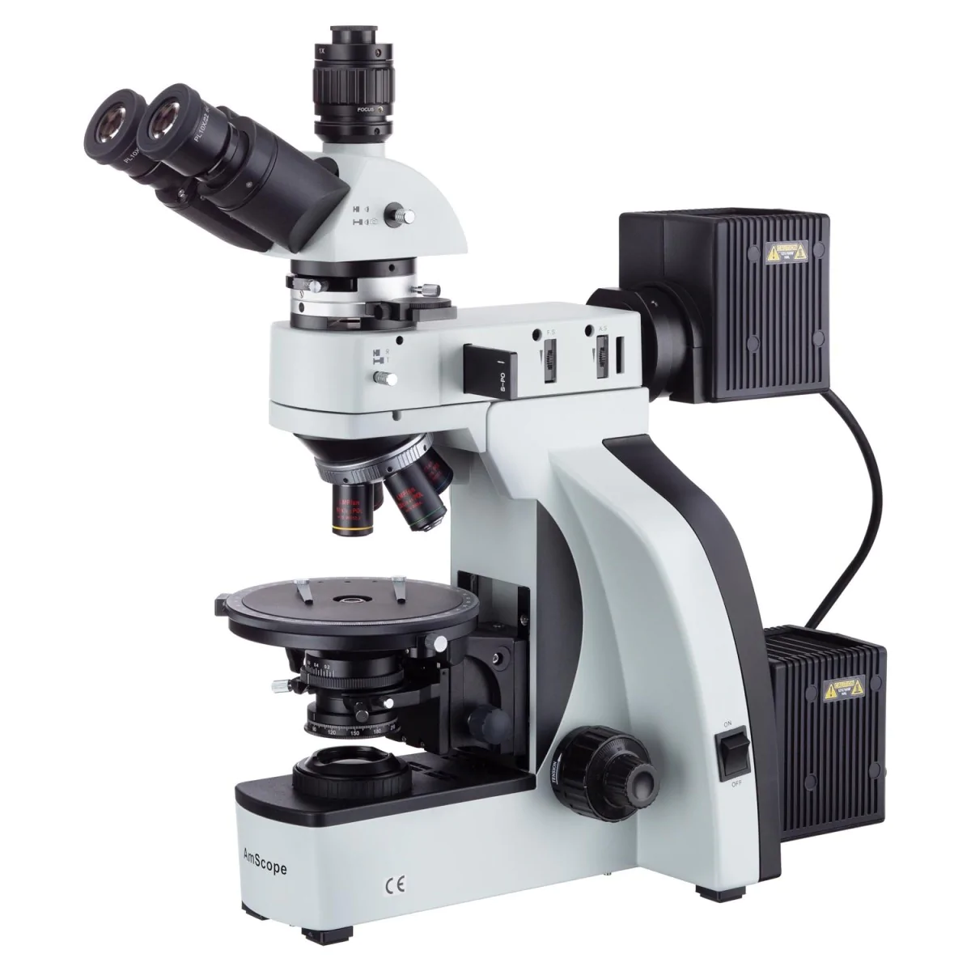
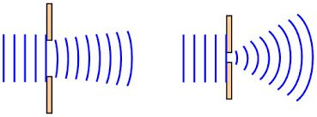
Optical microscopy and light diffraction

Slide 6
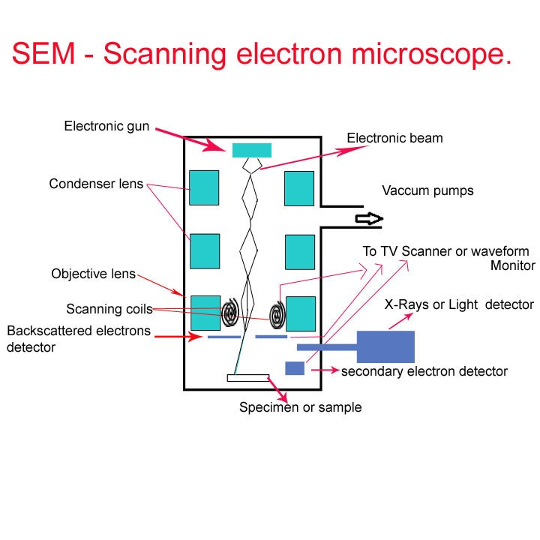
Scanning Electron Microscopy (SEM) with Energy Dispersive X-Ray Analysis (EDX)

Slide 7
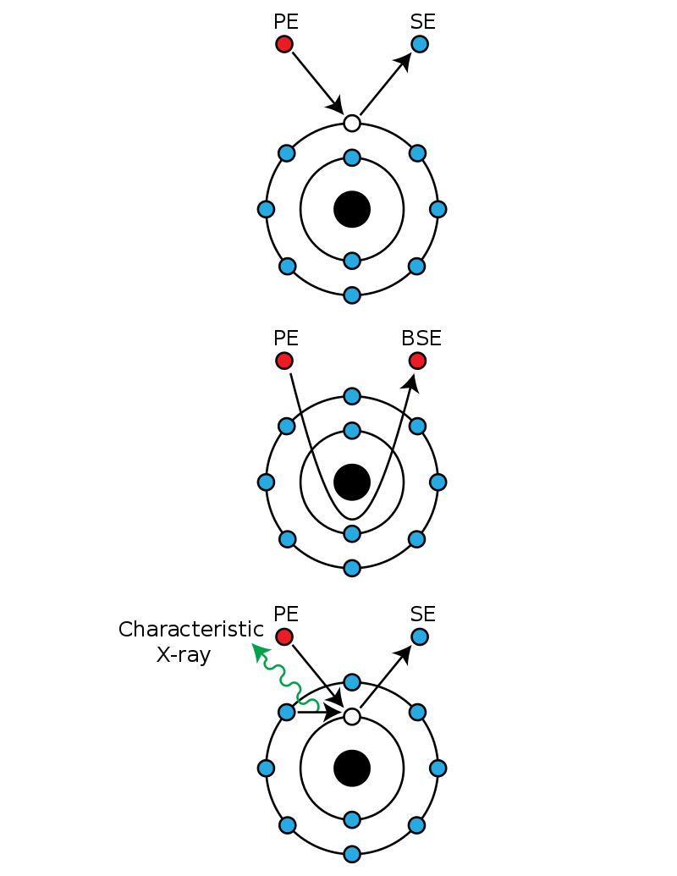
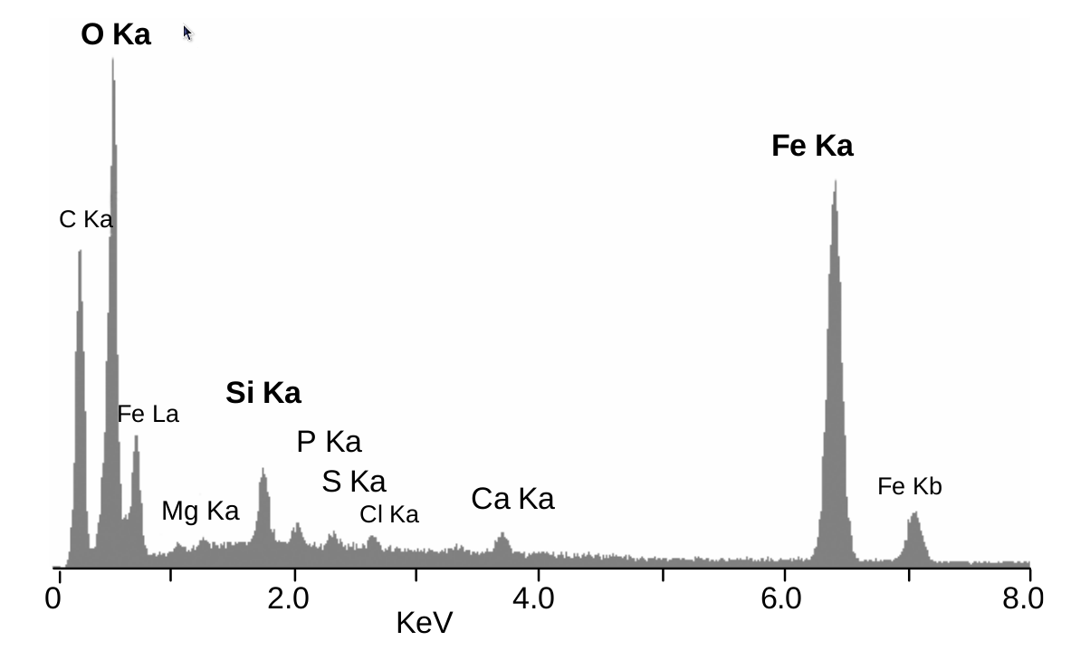
Energy dispersive X-ray spectroscopy (EDX)

Slide 8
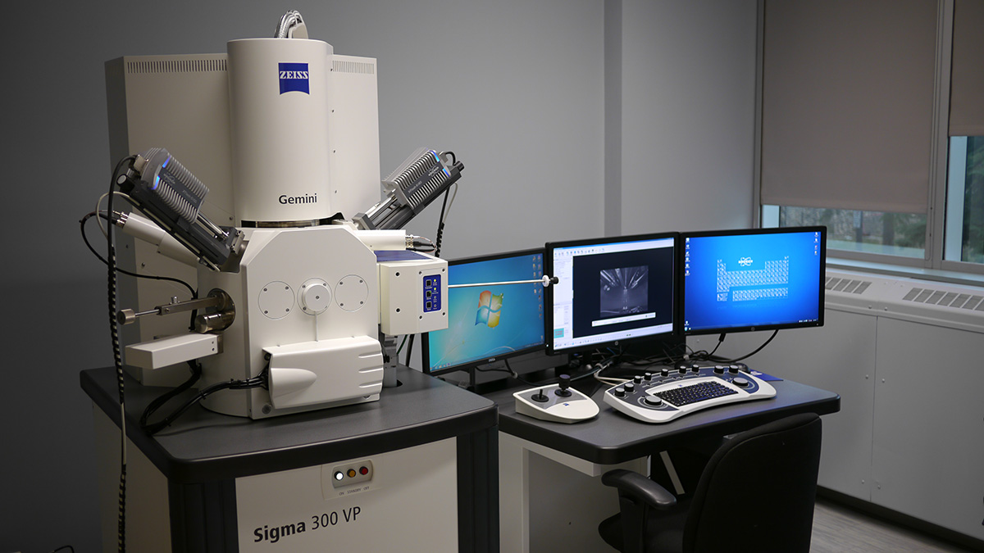
Scanning Electron Microscope

Slide 9
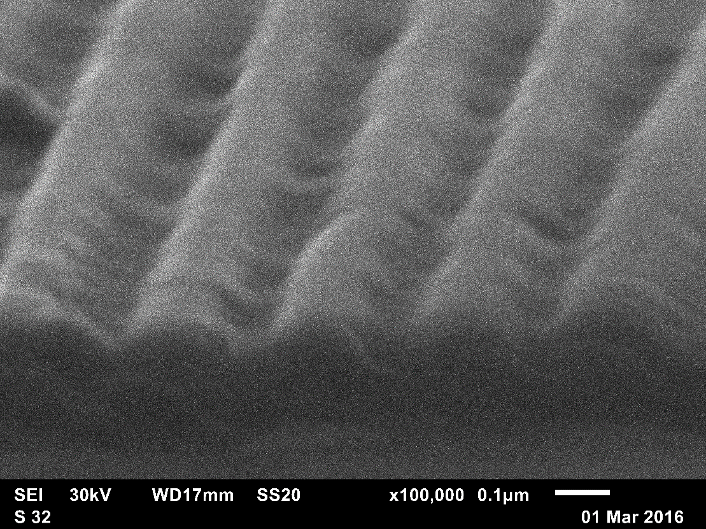
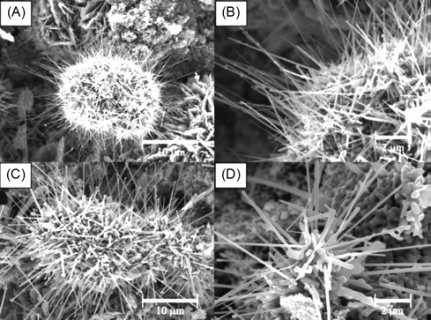
SEM images
SEM image of Si nanograting
SEM images of ZnO nanowires with different magnification

Slide 10
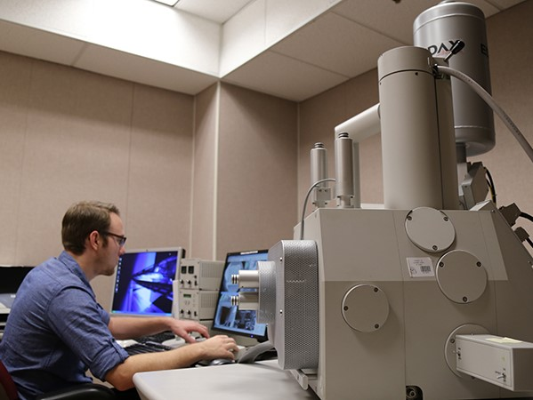
Environmental (ESEM)
Atmosphere gases pumped
Out but water pressure
is maintained.
Humidity =100%
Samples cooled down to
Cryogenic temperatures.

Slide 11
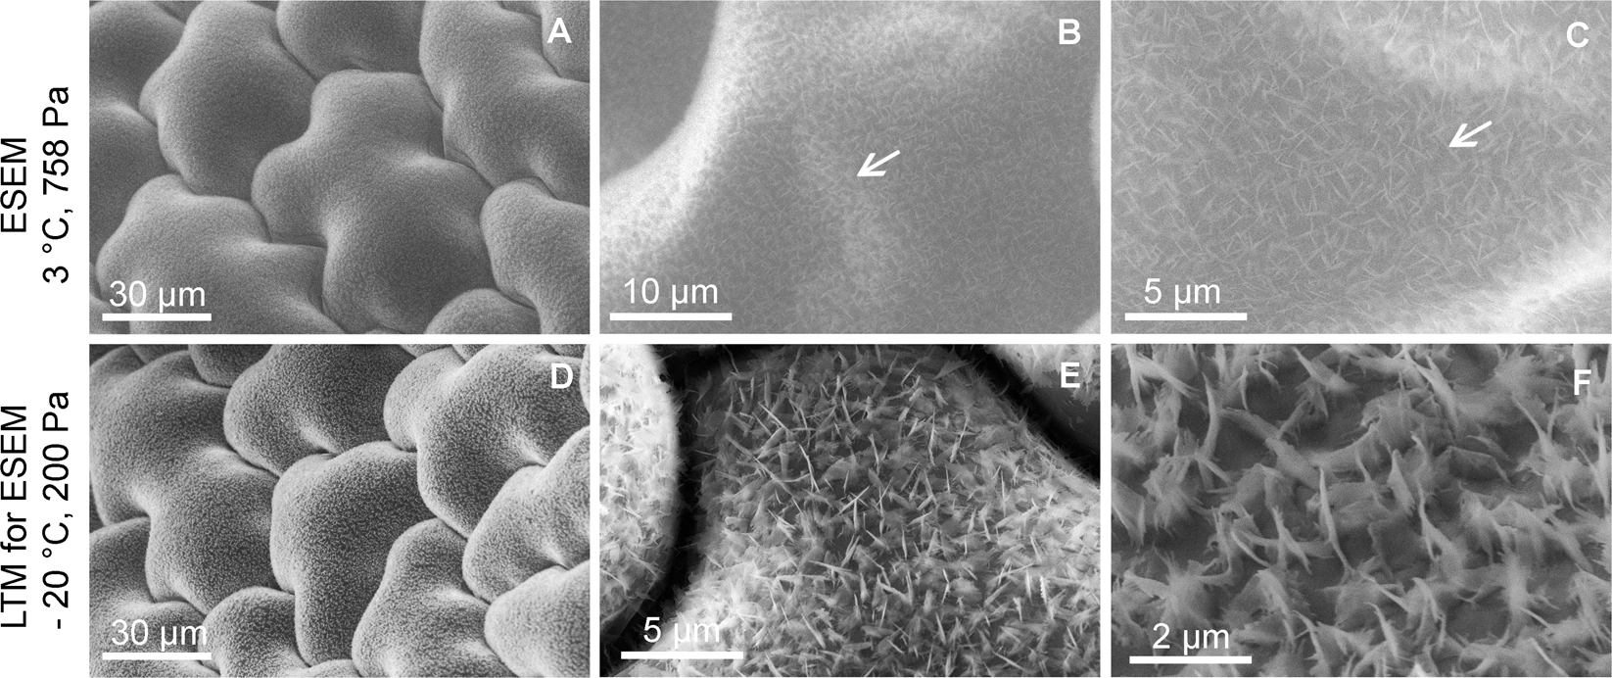
ESEM Images
Wax microstructure on the surface of an Oxalis acetosella leaf observed in its fully hydrated state

Slide 12
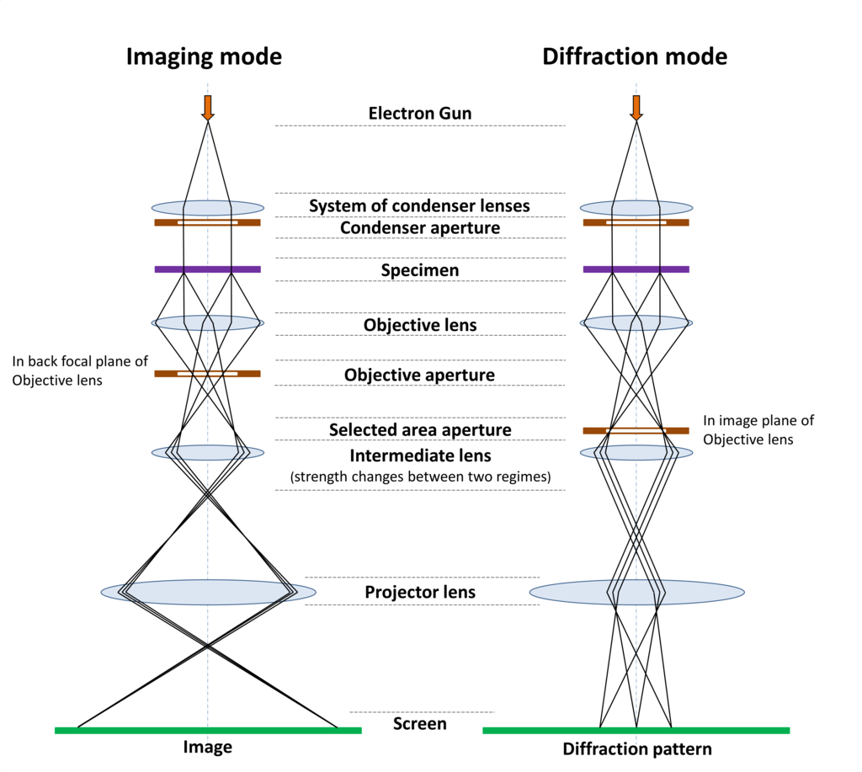
Transmission Electron Microscope (TEM)

Slide 13
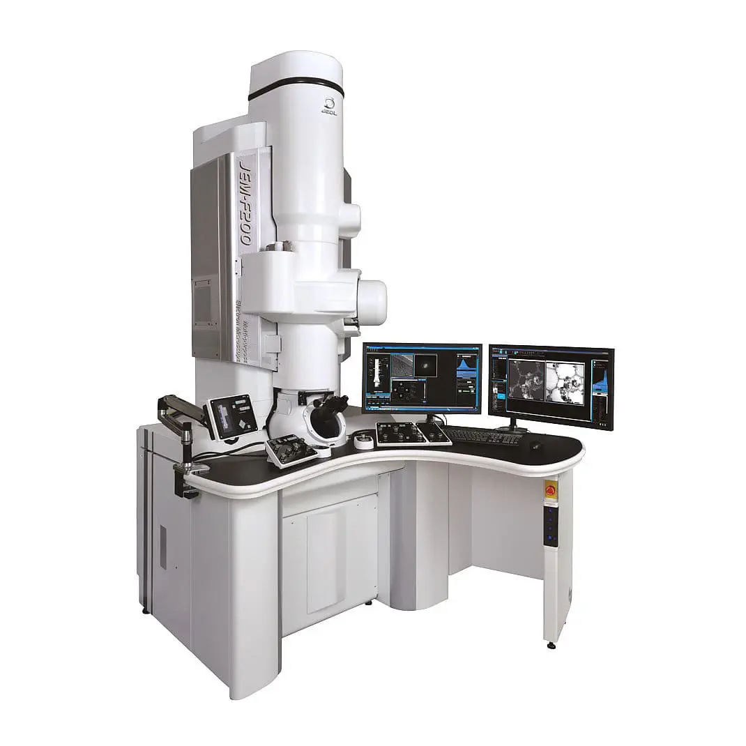
Transmission Electron Microscope (TEM)

Slide 14
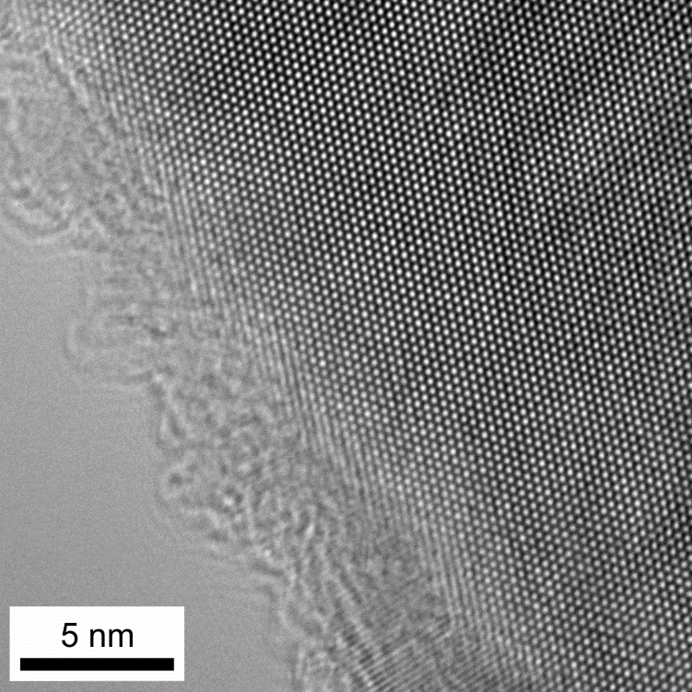
TEM image of Magnesium

Slide 15
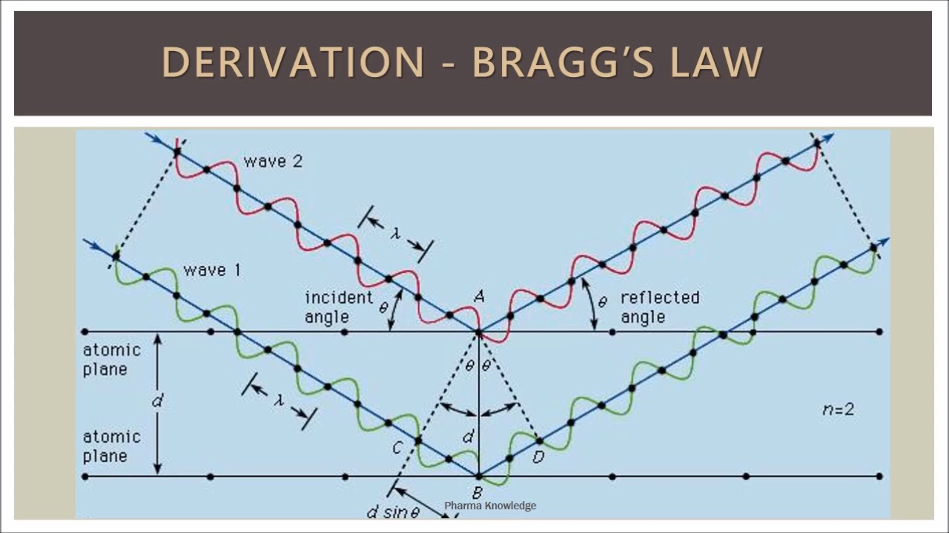
X-ray diffraction analysis

Slide 16
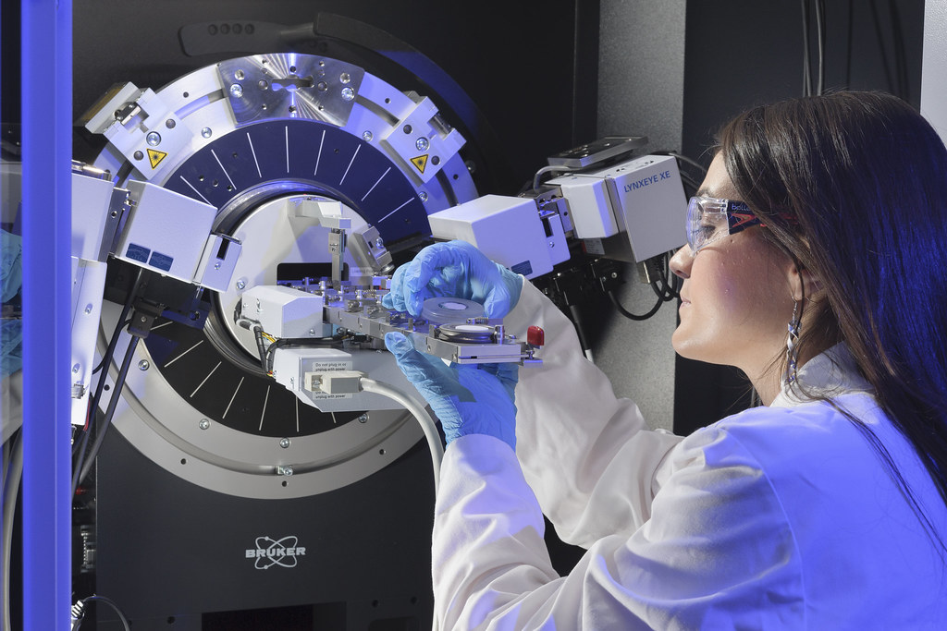
X-ray diffraction spectrometer

Slide 17
X-ray structural analysis of amorphous gold films

Slide 18
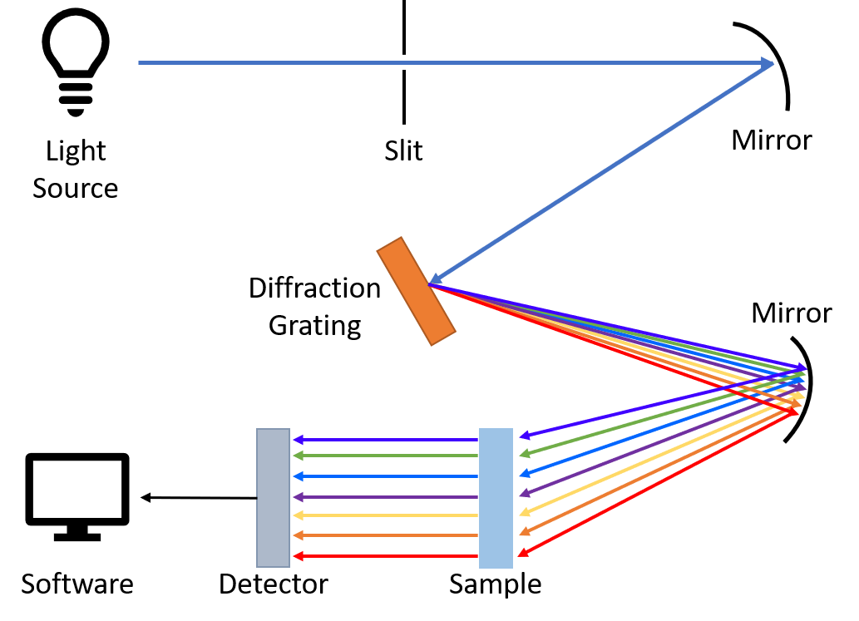
Optical and infrared spectroscopy

Slide 19
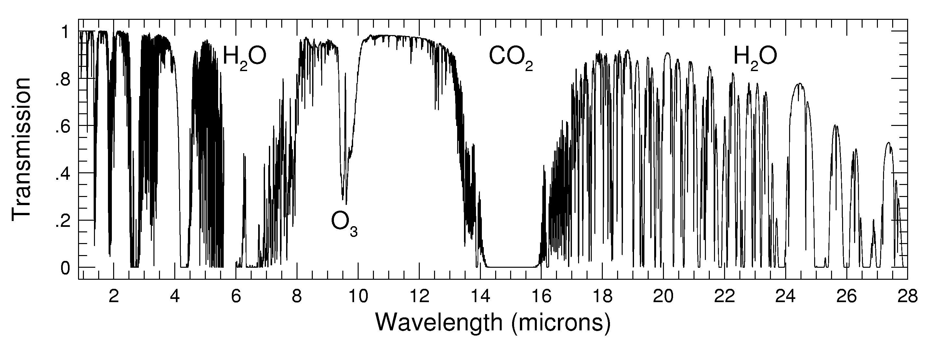
Transmission of electromagnetic waves through atmosphere

Slide 20
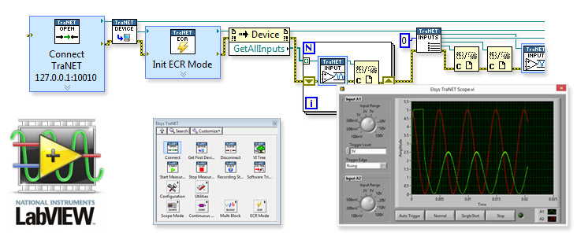
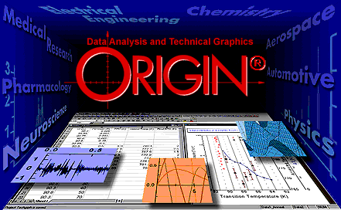
National Instruments LabVIEW and Microcal Origin software

Slide 21
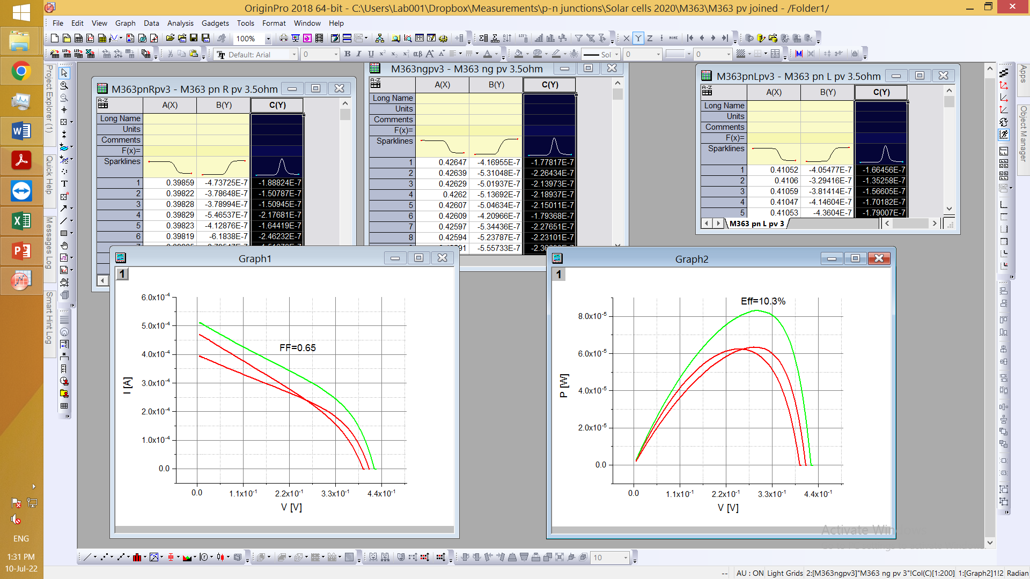
Solar cell characterization in Microcal Origin

Slide 22
Than You for attention!

